Slide 1
Lab 8 “Purely a Matter of Taste” Inference for a Population Proportion
STAT 201: Elementary Statistics

Slide 2
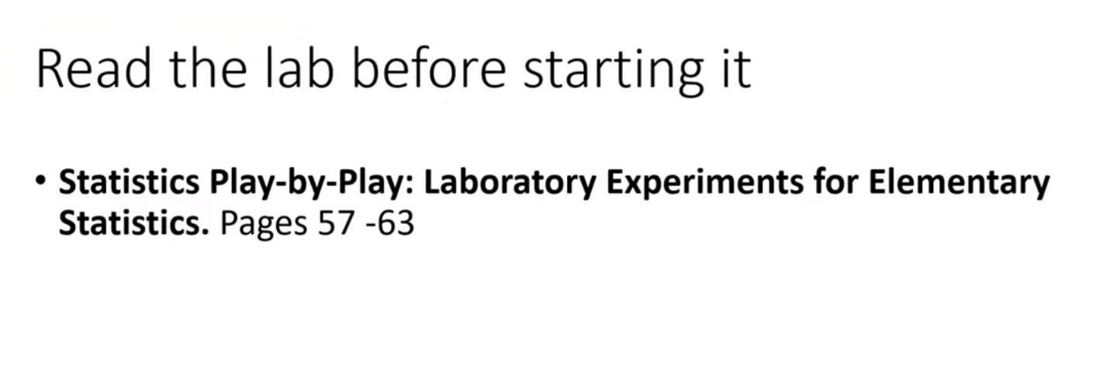

Slide 3
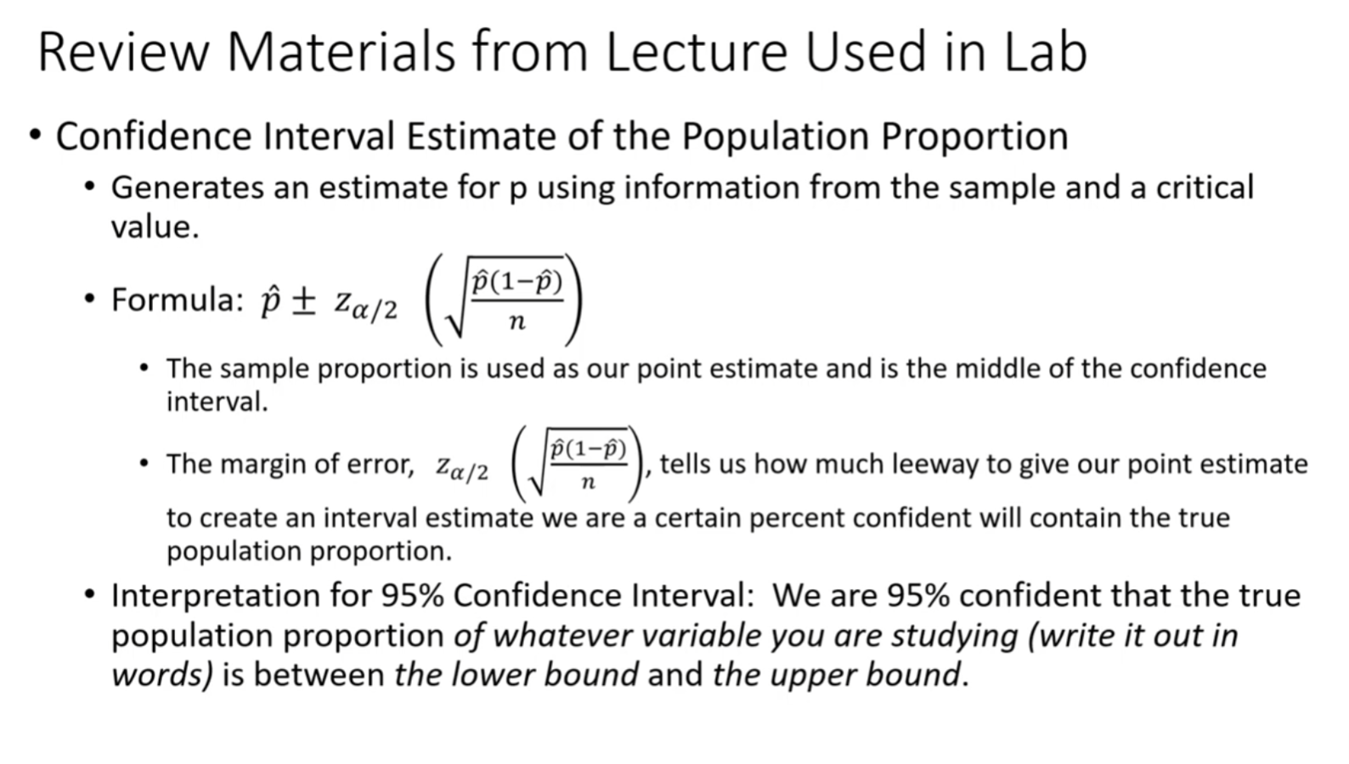

Slide 4
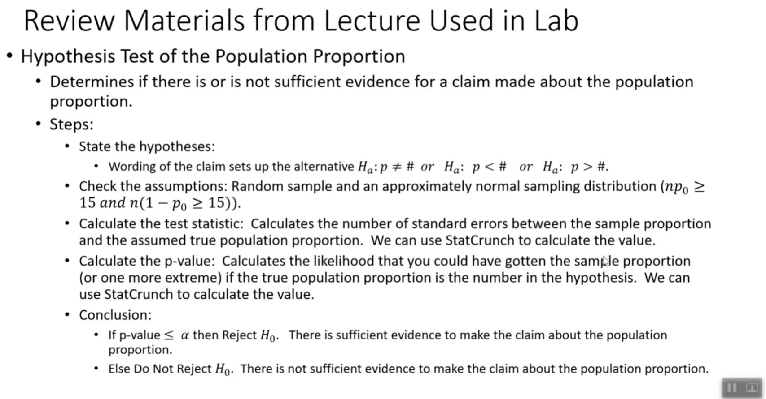

Slide 5
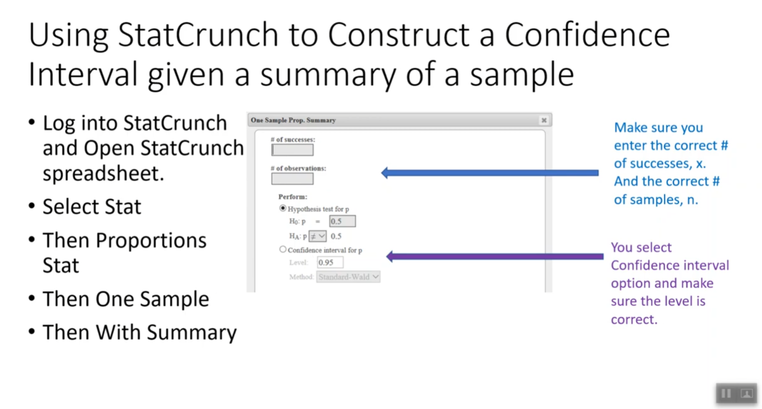

Slide 6
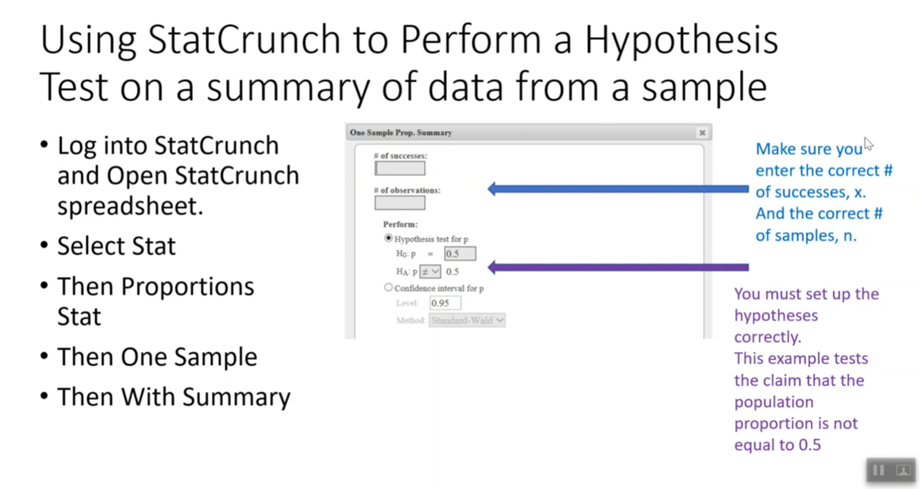

Slide 7
